Slide 1
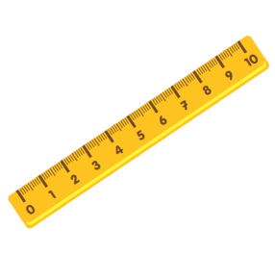
Unit 8:
This is my pen
Teacher: Mrs Ly
0988397716

Slide 2
VOCABULARY

Slide 3
VOCABULARY
pen
pens

Slide 4
VOCABULARY
rubber
eraser
rubbers
erasers

Slide 5
VOCABULARY
school bag
school bags

Slide 6
VOCABULARY
pencil
pencils

Slide 7
VOCABULARY
notebook
notebooks

Slide 8
VOCABULARY
pencil sharpener
pencil sharpeners

Slide 9
VOCABULARY
ruler
rulers

Slide 10
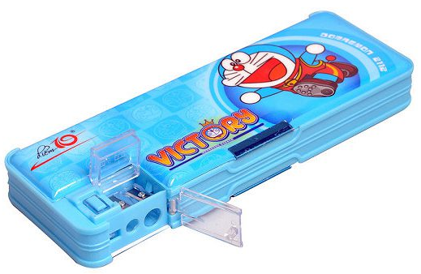
Review
eraser/ rubber
pencil sharpener
notebook
pens
pencils
pencil cases
school bags

Slide 11
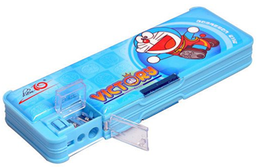
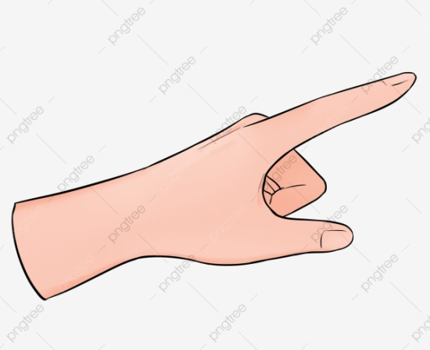
That
This

Slide 12
Those...
These ...

Slide 13
2. Point and say
This is my _____.
These are my _____.
pencil sharpener
pencils
pencil case
school bag
notebooks

Slide 14
2. Point and say
That is my _____.
Those are my _____.
pencil sharpener
pencils
pencil case
school bag
notebooks

Slide 15
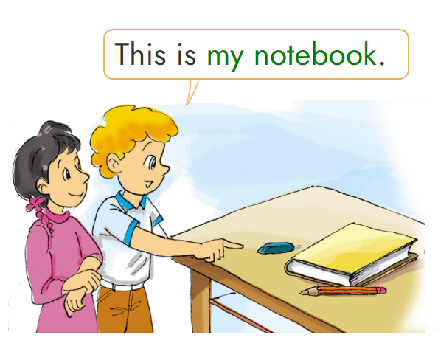
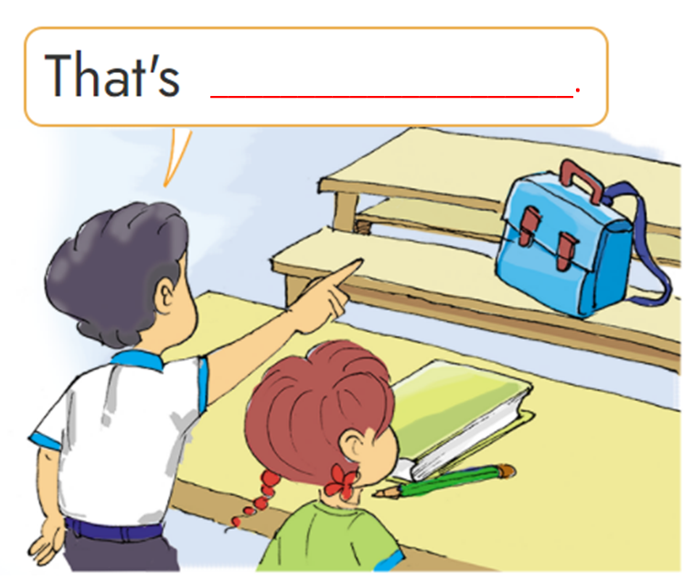
3. Let’s talk
my school bag
my notebook
my pencil
my pencil
my notebook
my rubber
_________________.
6
5
4
2
1
3

Slide 16
Hoa Mặt Trời
Notes:
Ms Huyền Phạm - 0936.082.789 – YOUTUBE: MsPham. Facebook: Dạy và học cùng công nghệ.

Slide 17
A
B
That is my bag.
This is my bag.
Notes:
Ms Huyền Phạm - 0936.082.789 – YOUTUBE: MsPham. Facebook: Dạy và học cùng công nghệ.

Slide 18
A
B
Those are my pencils.
This is my pencil.
Notes:
Ms Huyền Phạm - 0936.082.789 – YOUTUBE: MsPham. Facebook: Dạy và học cùng công nghệ.

Slide 19
A
B
Those are my notebook.
These are my notebooks.
Notes:
Ms Huyền Phạm - 0936.082.789 – YOUTUBE: MsPham. Facebook: Dạy và học cùng công nghệ.

Slide 20
A
B
That is my pencil sharpener.
This is my pencil sharpener.
Notes:
Ms Huyền Phạm - 0936.082.789 – YOUTUBE: MsPham. Facebook: Dạy và học cùng công nghệ.

Slide 21
A
B
These are my pencil cases.
This is my pencil case.
Notes:
Ms Huyền Phạm - 0936.082.789 – YOUTUBE: MsPham. Facebook: Dạy và học cùng công nghệ.

Slide 22
A
B
Those are my notebooks.
That is my notebook.
Notes:
Ms Huyền Phạm - 0936.082.789 – YOUTUBE: MsPham. Facebook: Dạy và học cùng công nghệ.

Slide 23
A
B
This is my pencils.
This is my pencil.
Notes:
Ms Huyền Phạm - 0936.082.789 – YOUTUBE: MsPham. Facebook: Dạy và học cùng công nghệ.

Slide 24
A
B
That is my sharpener.
This is my sharpener.
Notes:
Ms Huyền Phạm - 0936.082.789 – YOUTUBE: MsPham. Facebook: Dạy và học cùng công nghệ.

Slide 25
Notes:
Ms Huyền Phạm - 0936.082.789 – YOUTUBE: MsPham. Facebook: Dạy và học cùng công nghệ.

Slide 26
6. Let's play

Slide 27
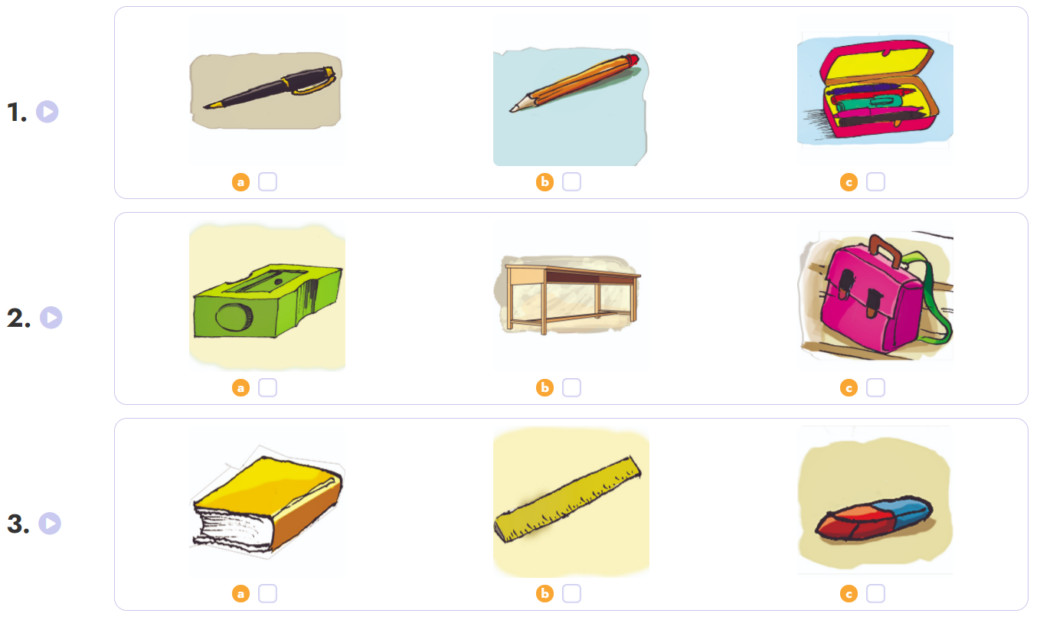
4. Listen and tick.

Slide 28
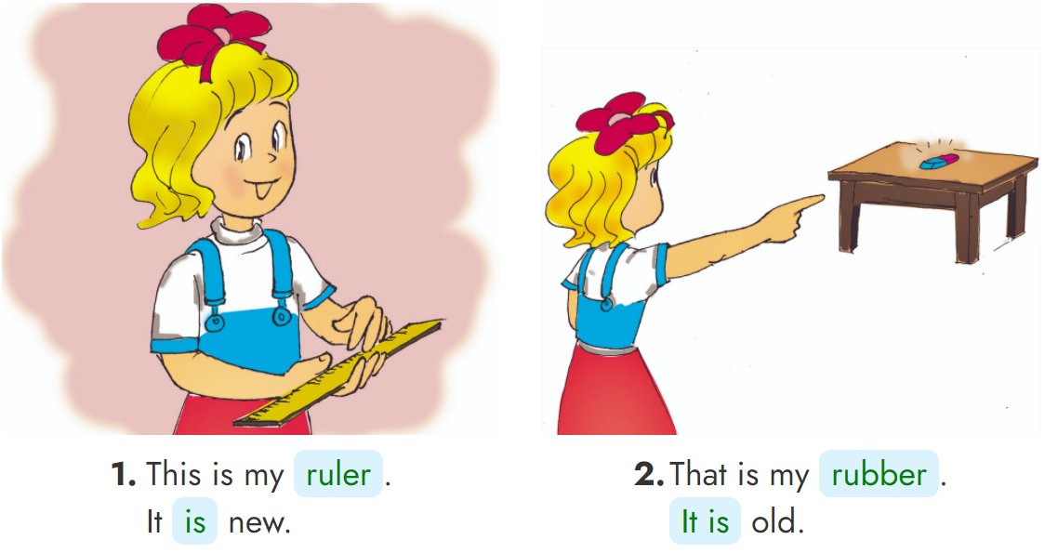
5. Look, read and write.
_____
______
___
_____

Slide 29
THANK YOU!
Welcome to join with me!
MsPham Powerpoint
Mspham

